Slide 1


Sureshkumar Subbiahpillai
October 30, 2022

Slide 2

Outline
Executive Summary
Introduction
Methodology
Results
Conclusion

Slide 3
Executive Summary
This project analyzes the cost saving method for a typical rocket launcher
Various data analytical methods have been used to predict the best result

Slide 4
Introduction
SpaceX project has been designed to reuse rocket launchers to enable cost savings
This project analyzes various cost saving methodologies using machine learning model

Slide 5

Section 1

Slide 6
Methodology
Executive Summary
Data collection methodology:
Data has been collected using SpaceX REST API
Perform data wrangling
Data has been processed various methods like Panda analyzing tool
Perform exploratory data analysis (EDA) using visualization and SQL
Perform interactive visual analytics using Folium and Plotly Dash
Perform predictive analysis using classification models

Slide 7
Data Collection
Data sets have been collected using API which gets processed from HTTP requests
Helper functions have been used to use API to extract information using identification numbers in the launch data.

Slide 8
Data Collection – SpaceX API
https://github.com/kumarsuresh2020/testrepo/blob/main/jupyter-labs-spacex-data-collection-api.ipynb

Slide 9
Data Collection - Scraping
Web scraping has been done using BeautifulSoup method
https://github.com/kumarsuresh2020/testrepo/blob/main/jupyter-labs-webscraping.ipynb

Slide 10
Data Wrangling
https://github.com/kumarsuresh2020/testrepo/blob/main/labs-jupyter-spacex-Data%20wrangling.ipynb

Slide 11
EDA with Data Visualization
https://github.com/kumarsuresh2020/testrepo/blob/main/jupyter-labs-eda-dataviz.ipynb

Slide 12
Build an Interactive Map with Folium
https://github.com/kumarsuresh2020/testrepo/blob/main/lab_jupyter_launch_site_location.ipynb

Slide 13
Predictive Analysis (Classification)
https://github.com/kumarsuresh2020/testrepo/blob/main/SpaceX_Machine%20Learning%20Prediction_Part_5.ipynb

Slide 14
Results
Exploratory data analysis manipulates data for easy interpretation
Interactive analytics demo in screenshots visualize results
Predictive analysis helps to decide the launch with optimized success rate

Slide 15

Section 2

Slide 16
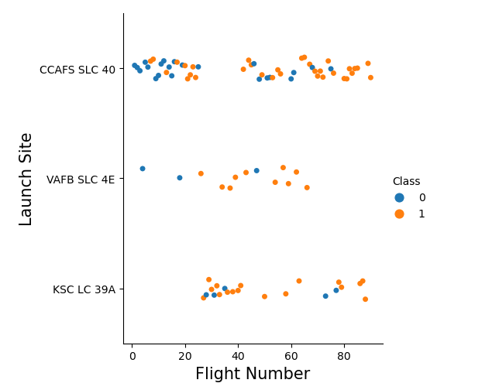
Flight Number vs. Launch Site

Slide 17
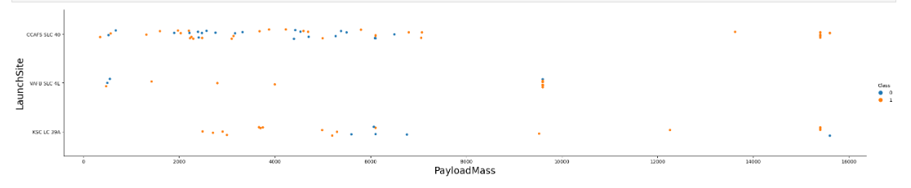
Payload vs. Launch Site

Slide 18
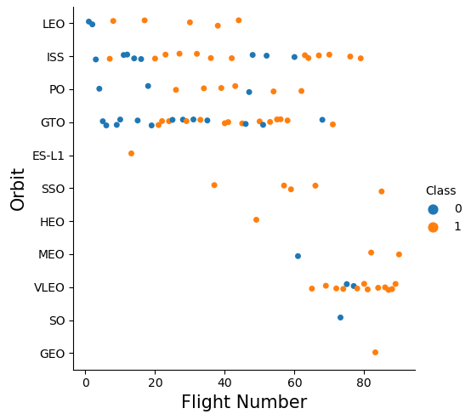
Flight Number vs. Orbit Type

Slide 19
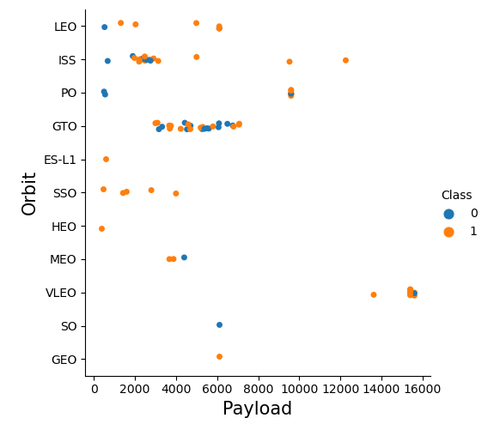
Payload vs. Orbit Type

Slide 20

Section 3

Slide 21
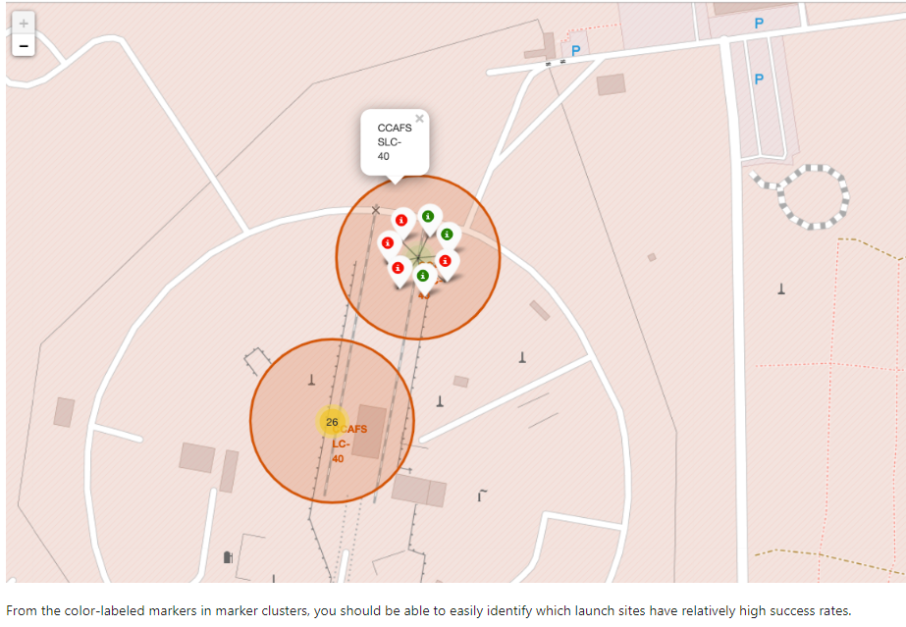
Folium Map Screenshot Launch site with successful rate

Slide 22
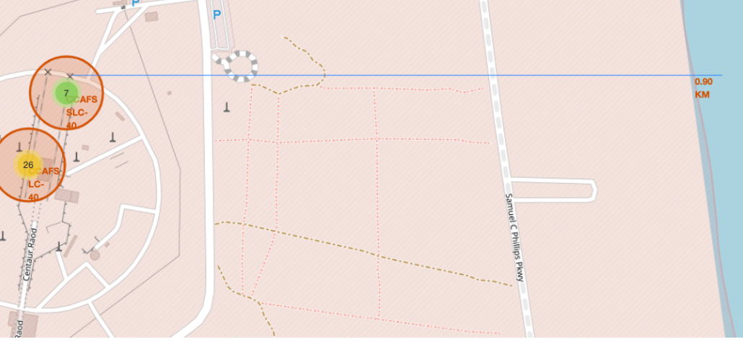
Folium Map Screenshot launch site to closest city

Slide 23

Section 4

Slide 24

Section 5

Slide 25
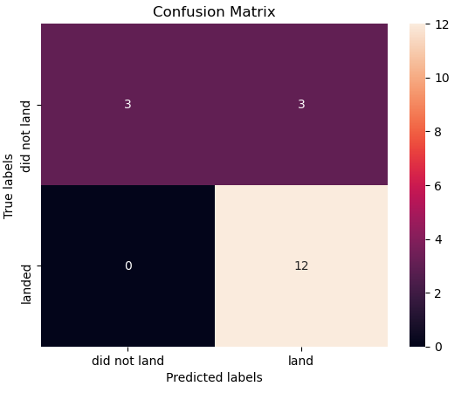
Confusion Matrix
Confusion matrix reveals false positive from logistic regression

Slide 26
Conclusions
Machine learning method helps to predict the result in advance
Data collection can be done with REST API
Data analysis can be made possible using Panda library

Slide 27


